Slide 1

Preparing Mathematicians for Big Data Careers An Insider’s Perspective
Paul Raff
Principal Data Scientist, Microsoft
Presentation to the AMS Special Session on Big Demand for Big Data
January 7, 2016

Slide 2




About Me
 | 2004 – BS Mathematics, BS Computer Science
 | 2009 – PhD Mathematics
 | 2010 – Applied Researcher, Supply Chain Research
 | 2012 – Principal Data Scientist, Analysis and Experimentation

Slide 3

Our Team
Microsoft’s Analysis and Experimentation Team
Accelerating innovation via trustworthy analysis and experimentation
http://www.exp-platform.com

Slide 4
Good Morning Ice-breaker

Slide 5


OneNote Welcome Email
Notes:
<<NEXT>> Example 2

Slide 6


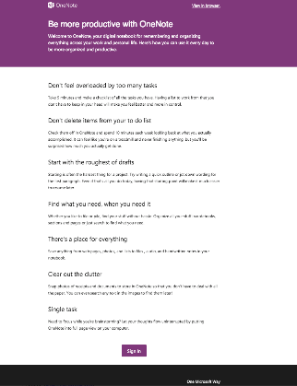
Welcome Email
A
Getting Started
B
Usage Tips
Which variant has more actions per user?
Raise your left hand if you think A Wins (left, “getting started”)
Raise your right hand if you think B Wins (right, “usage tips”)
Don’t raise your hand if they are the about the same
Notes:
<<NEXT>> Example 2 Results

Slide 7
Welcome Email
B
Usage Tips
WINNER IS
B
Which variant has more actions per user?
If you have your left hand up, sit down
If you have your right hand up, stay standing
If you have your no hand up, sit down
Notes:
Surprisingly, the Getting Started version did not show significant improvement over the Control.
The Usage Tips version, on the other hand, showed stat-sig lift of key metrics (e.g., actions and activity length) compared to the Control.
These were unexpected results!
The key takeaway is that controlled experimentation often uncovers insights that are not shown through other less rigorous approaches (e.g., before and after).
<<NEXT>> Example 3

Slide 8
Our Experience Hiring Data Scientists
I’ve been in charge of recruiting for the past 2 years, so I have been in contact with most/all of our candidates in the process.
500 | Applications considered
250 | First phone screens
120 | Second phone screens
60 | Onsite interviews
20 | Offers for employment given

Slide 9
The Questions We Will Address Today
What does it take for a mathematics or a statistics major to both find a data science job and succeed in a data science career?
What steps can faculty and educators take to facilitate this process?

Slide 10
The Data Science Venn Diagram
Understanding the Data Science Venn Diagram can help faculty better prepare their students for careers in data science.
Let’s go through the venn diagram piece by piece and discuss how this can shape and inform.
Computer Science
Skills
Mathematics/
Statistics
Knowledge
Machine
Learning
Scientist
Data
Scientist
Danger
Zone!
Traditional
Researcher
Substantive Expertise
Domain Knowledge
Thanks to Drew Conway

Slide 11
The Data Science Venn Diagram
Here’s your primary sphere of influence as educators.
Computer Science
Skills
Mathematics/
Statistics
Knowledge
Machine
Learning
Scientist
Data
Scientist
Danger
Zone!
Traditional
Researcher
Substantive Expertise
Domain Knowledge
Thanks to Drew Conway

Slide 12
The Data Science Venn Diagram
Here’s your primary sphere of influence as educators.
Great work! There’s no risk of being in the Danger Zone as long as the math/stats fundamentals are retained.
Computer Science
Skills
Mathematics/
Statistics
Knowledge
Machine
Learning
Scientist
Data
Scientist
Danger
Zone!
Traditional
Researcher
Substantive Expertise
Domain Knowledge
Thanks to Drew Conway

Slide 13
The Data Science Venn Diagram
Now, let’s focus on these two portions of the venn diagram.
They are equally-sized, and that is appropriate.
Computer Science
Skills
Mathematics/
Statistics
Knowledge
Machine
Learning
Scientist
Data
Scientist
Danger
Zone!
Traditional
Researcher
Substantive Expertise
Domain Knowledge
Thanks to Drew Conway

Slide 14
The Data Science Venn Diagram
Now, let’s focus on these two portions of the venn diagram.
They are equally-sized, and that is appropriate.
Strive to continuously incorporate computer programming more and more into your math/stats curriculum.
Computer Science
Skills
Mathematics/
Statistics
Knowledge
Machine
Learning
Scientist
Data
Scientist
Danger
Zone!
Traditional
Researcher
Substantive Expertise
Domain Knowledge
Thanks to Drew Conway

Slide 15

Example 1 – Solving Empirically
Particularly in initial probability courses, most problems have a path to an empirically-found solution via computer programming means.
Ant-on-a-square problem:

Slide 16
Example 1 – Solving Empirically
Particularly in initial probability courses, most problems have a path to an empirically-found solution via computer programming means.
Ant-on-a-square problem:

Slide 17
Example 1 – Solving Empirically
Particularly in initial probability courses, most problems have a path to an empirically-found solution via computer programming means.
Ant-on-a-square problem:

Slide 18
Example 1 – Solving Empirically
Particularly in initial probability courses, most problems have a path to an empirically-found solution via computer programming means.
Ant-on-a-square problem:

Slide 19
Example 1 – Solving Empirically
Particularly in initial probability courses, most problems have a path to an empirically-found solution via computer programming means.
Ant-on-a-square problem:

Slide 20
Example 1 – Solving Empirically
Simulate!
Any language you want, but concisely in R:
trials <- 2*(rnbinom(10000, 1, 0.5)+1)
Leads naturally to the conversation of uncertainty

Slide 21
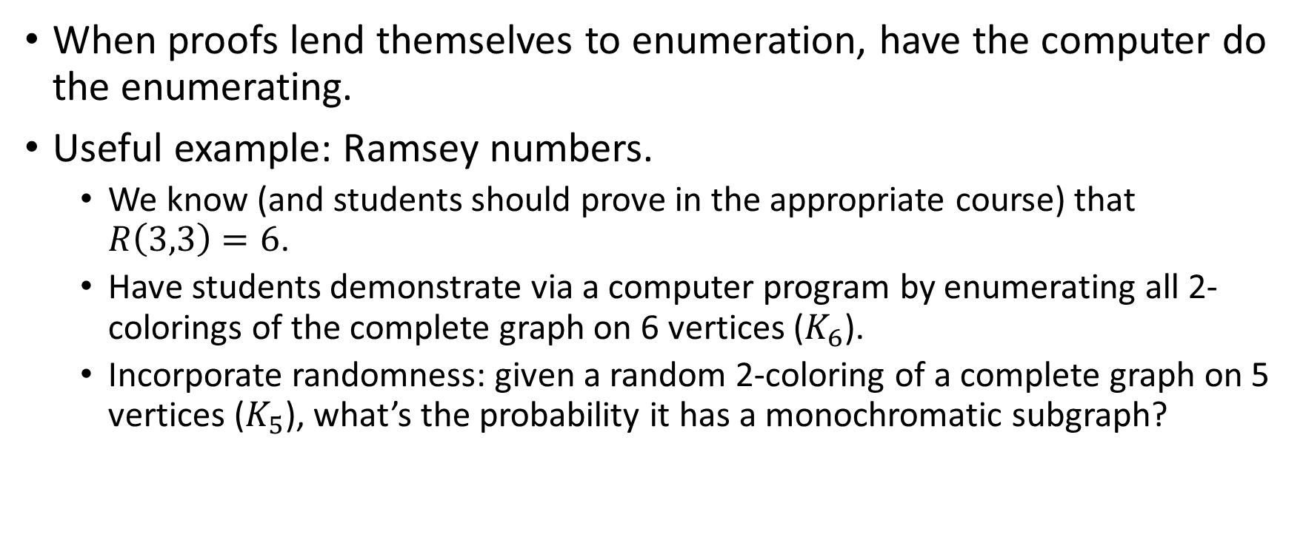
Example 2 – Learning via Brute Force
When proofs lend themselves to enumeration, have the computer do the enumerating.
Useful example: Ramsey numbers.
We know (and students should prove in the appropriate course) that $R\left(3,3\right)=6$.
Have students demonstrate via a computer program by enumerating all 2-colorings of the complete graph on 6 vertices ($K_{6}$).
Incorporate randomness: given a random 2-coloring of a complete graph on 5 vertices ($K_{5}$), what’s the probability it has a monochromatic subgraph?

Slide 22
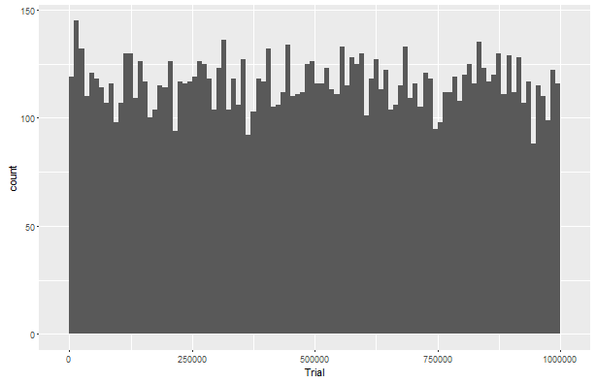
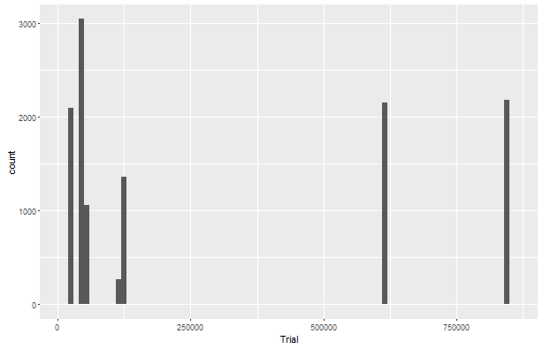
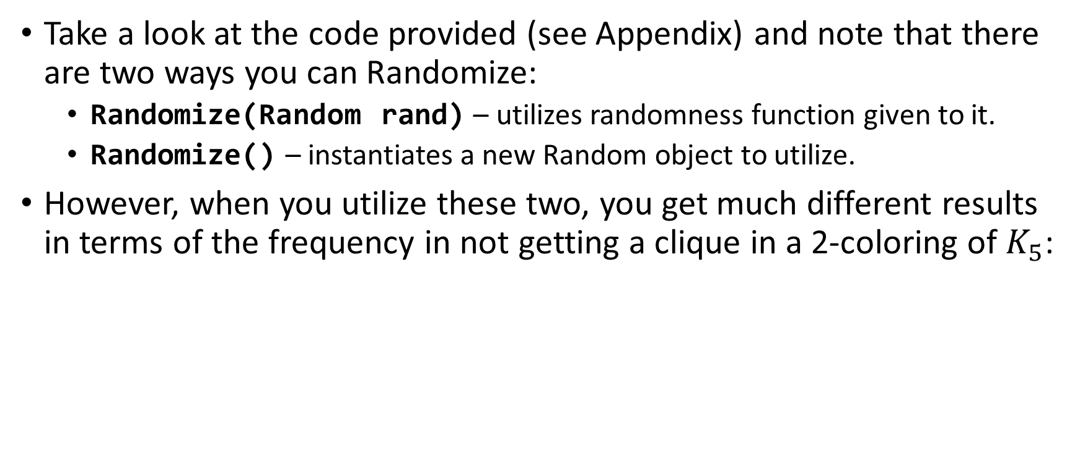
Example 2 – Learning via Brute Force
Take a look at the code provided (see Appendix) and note that there are two ways you can Randomize:
Randomize(Random rand) – utilizes randomness function given to it.
Randomize() – instantiates a new Random object to utilize.
However, when you utilize these two, you get much different results in terms of the frequency in not getting a clique in a 2-coloring of $K_{5}$:
Using common random function throughout
Using new random function each call

Slide 23
Example 2 – Learning via Brute Force What’s Going On?
This is now a data science exercise!
The good data scientist can not only identify which of the two scenariois abnormal against expectation, but can also explain why the observed phenomenon is occurring.
Hint

Slide 24
The Data Science Venn Diagram
This will likely be the greatest challenge to affect as an educator.
Nothing comes close to actual on-the-job experience.
Emphasize internships over traditional summer research opportunities.
Computer Science
Skills
Mathematics/
Statistics
Knowledge
Machine
Learning
Scientist
Data
Scientist
Danger
Zone!
Traditional
Researcher
Substantive Expertise
Domain Knowledge
Thanks to Drew Conway

Slide 25
The Data Science Venn Diagram
Additionally, graduate school is in some senses a mandatory pre-requisite for data science careers.
Computer Science
Skills
Mathematics/
Statistics
Knowledge
Machine
Learning
Scientist
Data
Scientist
Danger
Zone!
Traditional
Researcher
Substantive Expertise
Domain Knowledge
Thanks to Drew Conway

Slide 26
The Biggest Challenge
There are three great career opportunities here – which one is the best for any particular student?
Always a difficult question, but there are two specific situations you should be cognizant of.
Computer Science
Skills
Mathematics/
Statistics
Knowledge
Machine
Learning
Scientist
Data
Scientist
Danger
Zone!
Traditional
Researcher
Substantive Expertise
Domain Knowledge
Thanks to Drew Conway

Slide 27
The Biggest Challenge
The I’m looking for a data scientist but I actually want a software developer situation.
Computer Science
Skills
Mathematics/
Statistics
Knowledge
Machine
Learning
Scientist
Data
Scientist
Danger
Zone!
Traditional
Researcher
Substantive Expertise
Domain Knowledge
Thanks to Drew Conway

Slide 28
The Biggest Challenge
The I’m looking for a data scientist but I actually want a software developer situation.
This is primarily seen in teams that are firmly software development-focused looking for one data scientist to join their ranks.
Computer Science
Skills
Mathematics/
Statistics
Knowledge
Machine
Learning
Scientist
Data
Scientist
Danger
Zone!
Traditional
Researcher
Substantive Expertise
Domain Knowledge
Thanks to Drew Conway

Slide 29
The Biggest Challenge
The data scientist v. machine learning scientist situation.
It’s well-expressed in the venn diagram; data scientists are firmly focused on the business needs.
Computer Science
Skills
Mathematics/
Statistics
Knowledge
Machine
Learning
Scientist
Data
Scientist
Danger
Zone!
Traditional
Researcher
Substantive Expertise
Domain Knowledge
Thanks to Drew Conway

Slide 30
Summary
When you’re assessing whether or not your students are on the right track for a career in data science, consult the venn diagram.
Incorporate computer programming and engineering as much as possible in your curriculum.
On top of required courses from the computer science/computer engineering department.
Continue the push for graduate school when applicable, but realize that graduate school isn’t just for budding academic faculty anymore.

Slide 31
Thank You!
Questions?
Code samples from here can be found at https://github.com/paulraff/2016JointMeetings
Thanks to Drew Conway for making his venn diagram available via Creative Commons. License information.

Slide 32
Digression – Geeking out on Rand()
A naïve implementation of this situation would use Rand() inside the randomize function, which results in very interesting behavior.

Slide 33
The Data Science Venn Diagram
Also, note what’s not available when you are lacking mathematics and statistics knowledge. This is important. When a student is choosing between a computer science major and a mathematics major, then that student should choose mathematics.
Computer Science
Skills
Mathematics/
Statistics
Knowledge
Machine
Learning
Scientist
Data
Scientist
Danger
Zone!
Traditional
Researcher
Substantive Expertise
Domain Knowledge
Thanks to Drew Conway

Slide 34
The Data Science Venn Diagram
Understanding the Data Science Venn Diagram can help faculty better prepare their students for careers in data science.
Computer Science
Skills
Mathematics/
Statistics
Knowledge
Machine
Learning
Scientist
Data
Scientist
Danger
Zone!
Traditional
Researcher
Substantive Expertise
Domain Knowledge
Thanks to Drew Conway

Slide 35
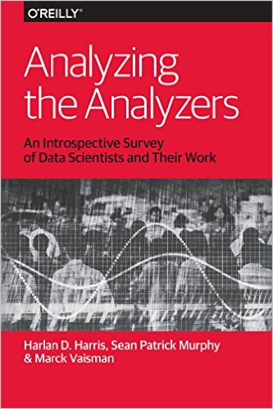
Resources
Analyzing the Analyzers
Useful summary of the different types of data scientists that exist.
Data Businesspeople
Data Creatives
Data Developers
Data Researchers

Slide 36
Appendix

